Slide 1
Team Thinkers
Summer Vacation v2.3

Slide 2
Team Members
Xuan(Zoe) Ji
https://github.com/zoeji569
Sushma Pakhreen
https://github.com/spakhre
Justin Hammel
https://github.com/thirdeye18/Summer-Vacation

Slide 3

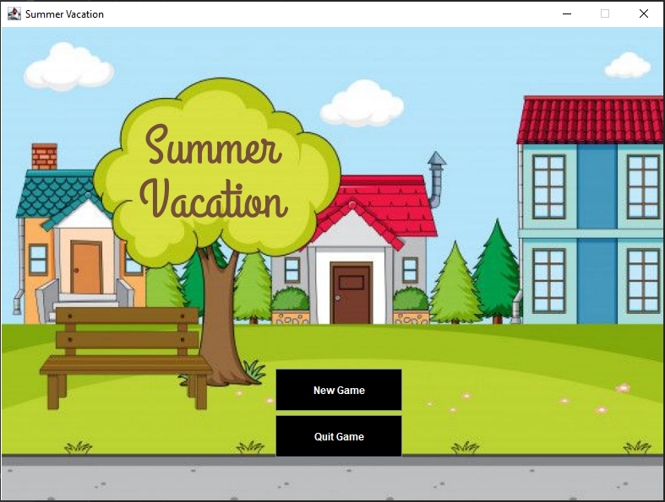
Game Introduction
Spend the summer with your best friend solving a creepy mystery and save the kids of your town! You and your best friend find yourselves at the heart of a plot involving a farmer, an airplane, and an old suitcase. Let's go explore the town and resolve tasks!

Slide 4

Learning/Challenges (Zoe)
Agile principles / MVP
Backlog managing
GUI
Buttons vs text input
User experience

Slide 5
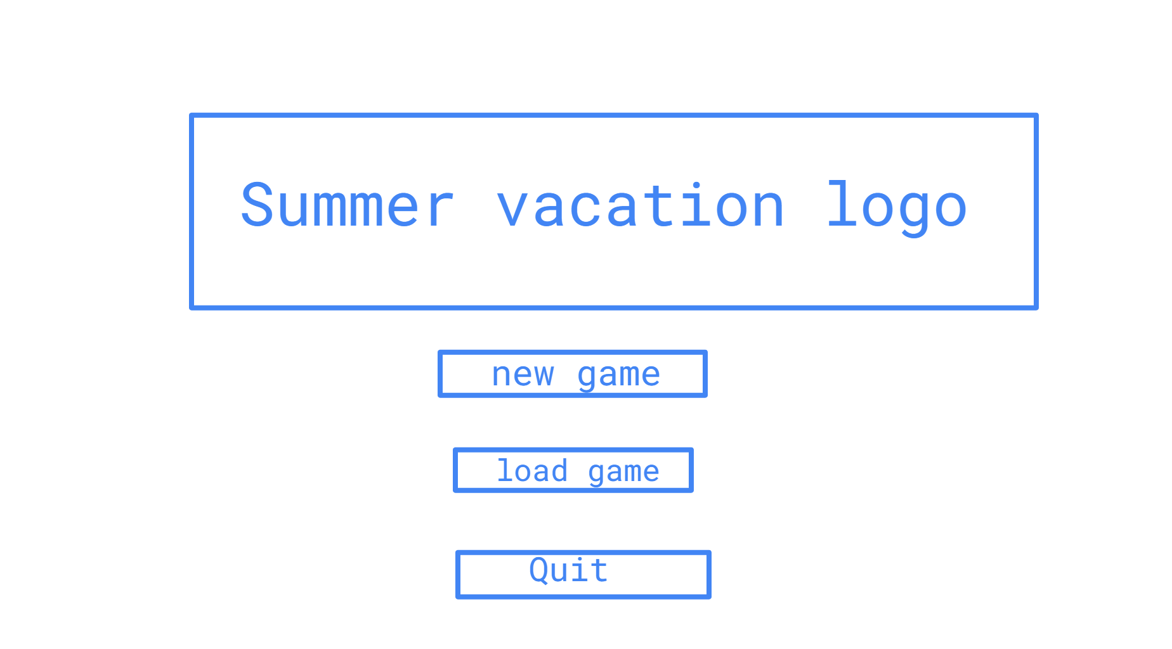
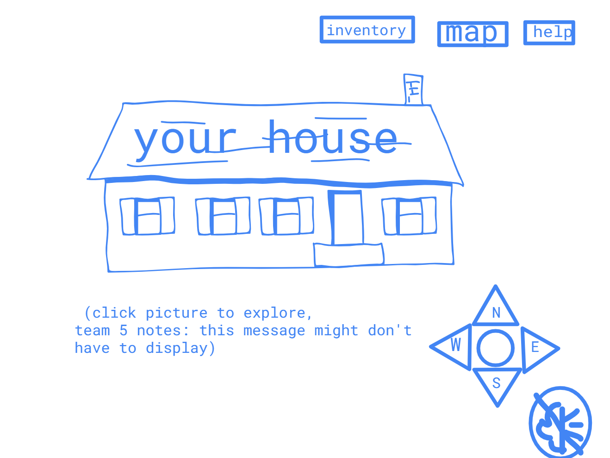
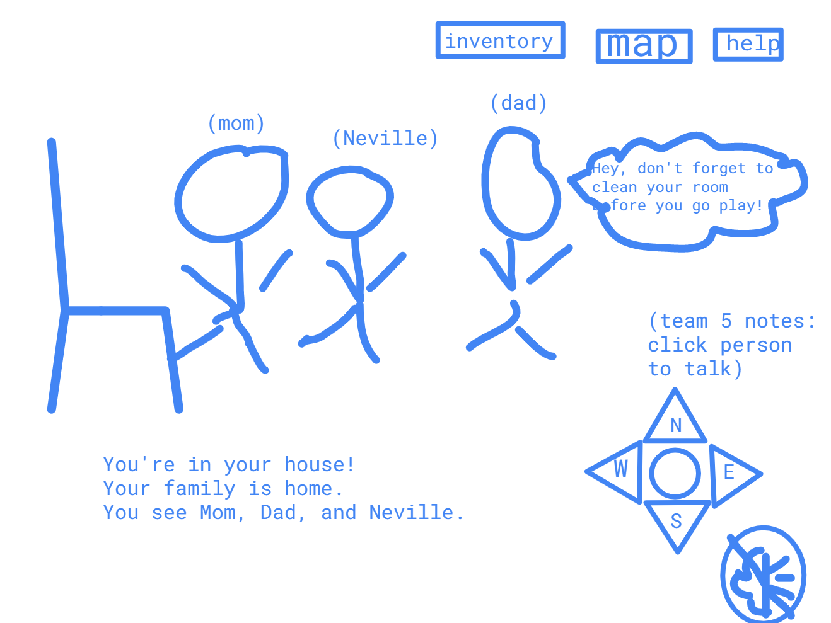
Prototyping

Slide 6
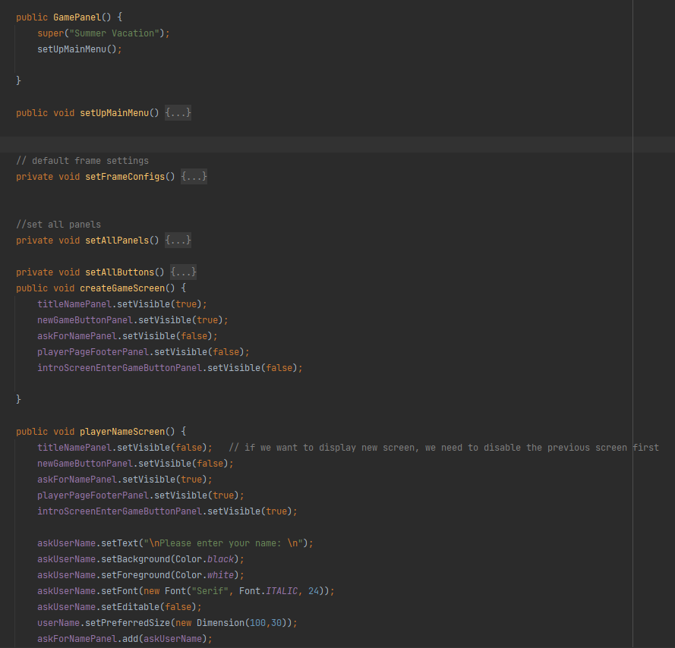
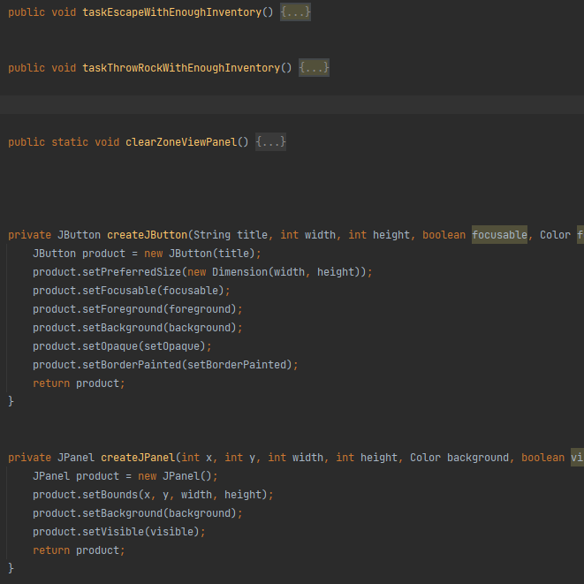
GamePanel.java

Slide 7
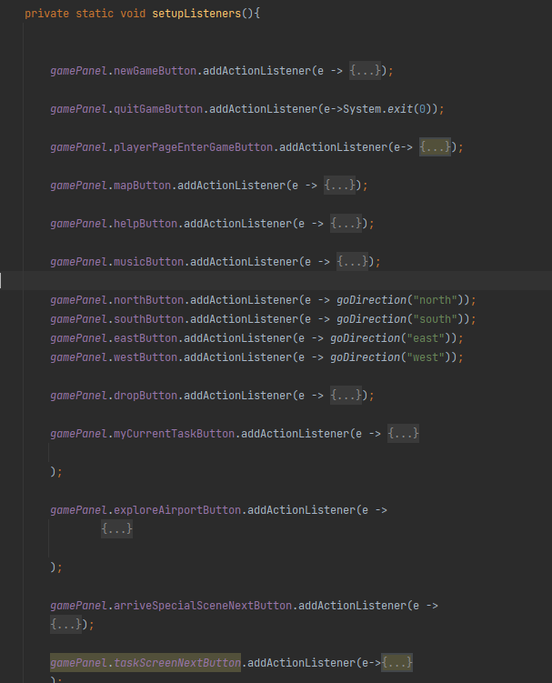
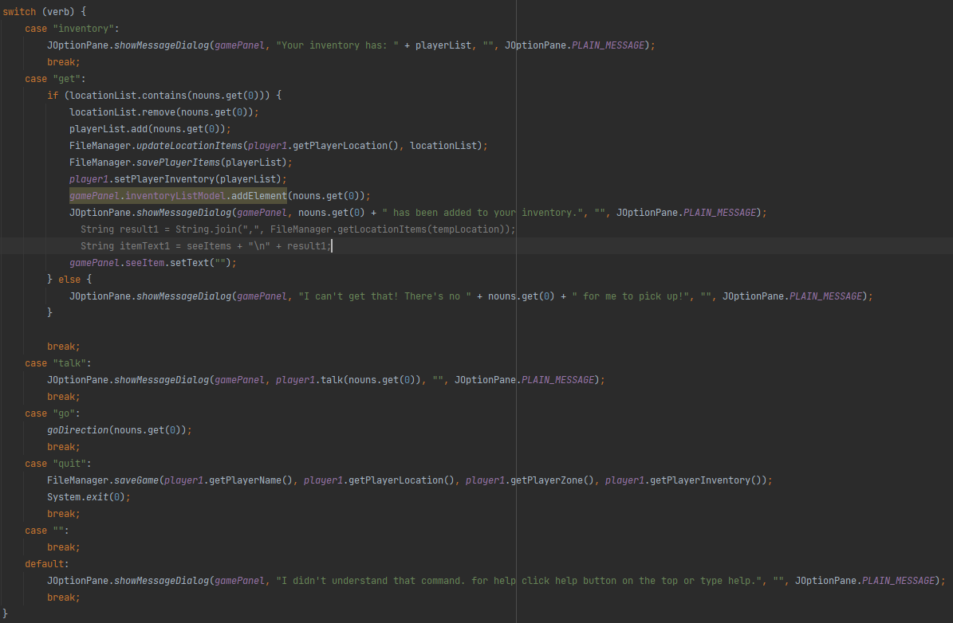
Input.java

Slide 8
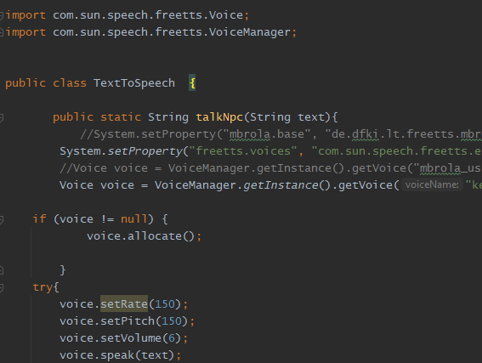
Learning/Challenges (Sushma)
Use available libraries(TextToSpeech)
Task Management(Azure Board)
SWING
MVC
Debugging
Cross Platform Compatibility

Slide 9
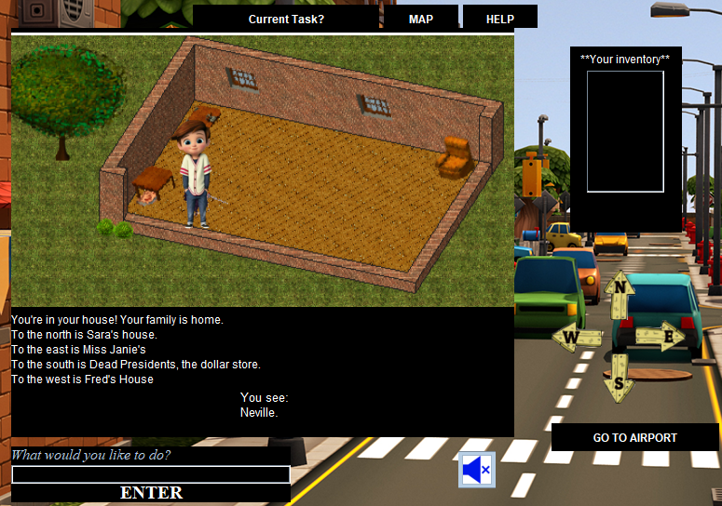
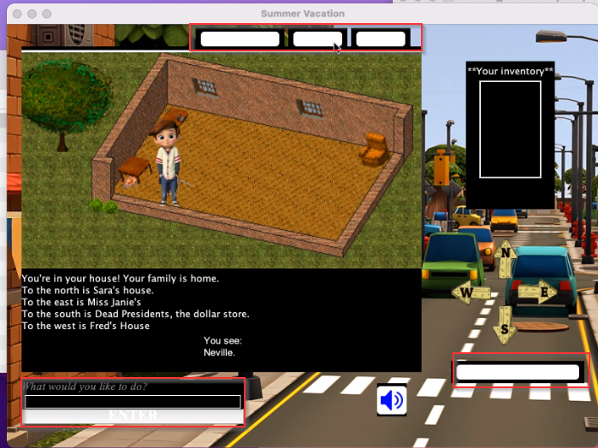
Windows
Mac

Slide 10
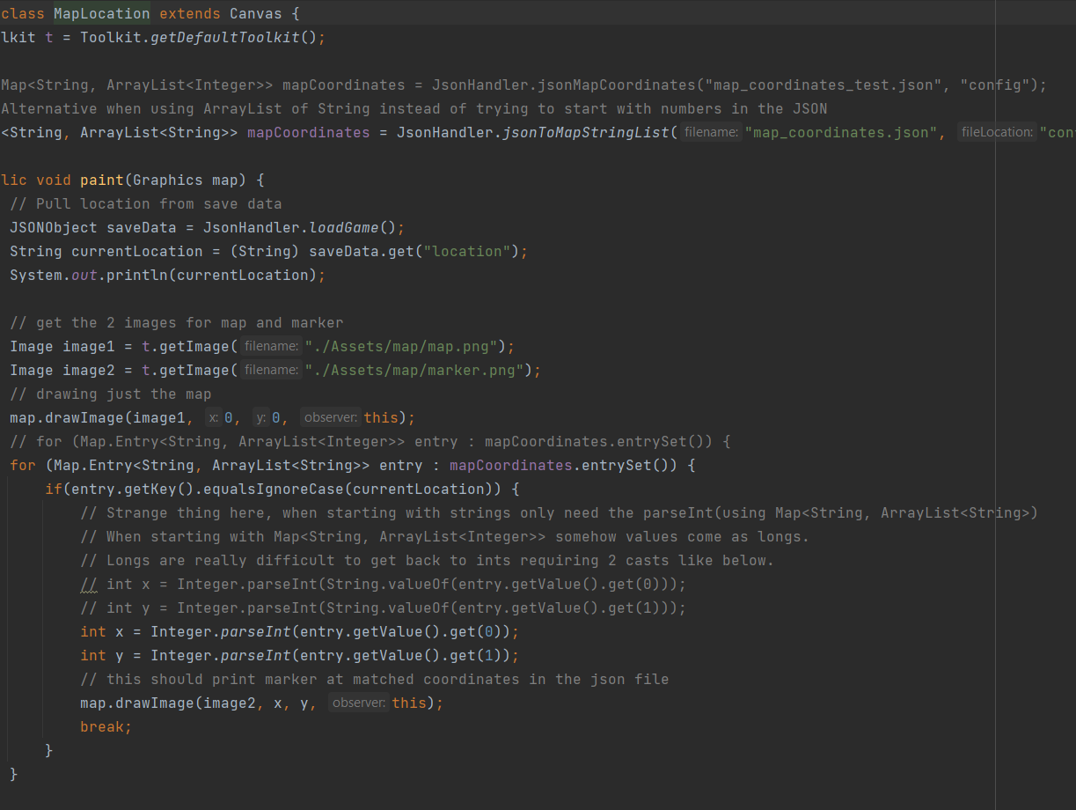
Learning/Challenges (justin)
Swing was a big challenge
Overlaying images dynamically

Slide 11
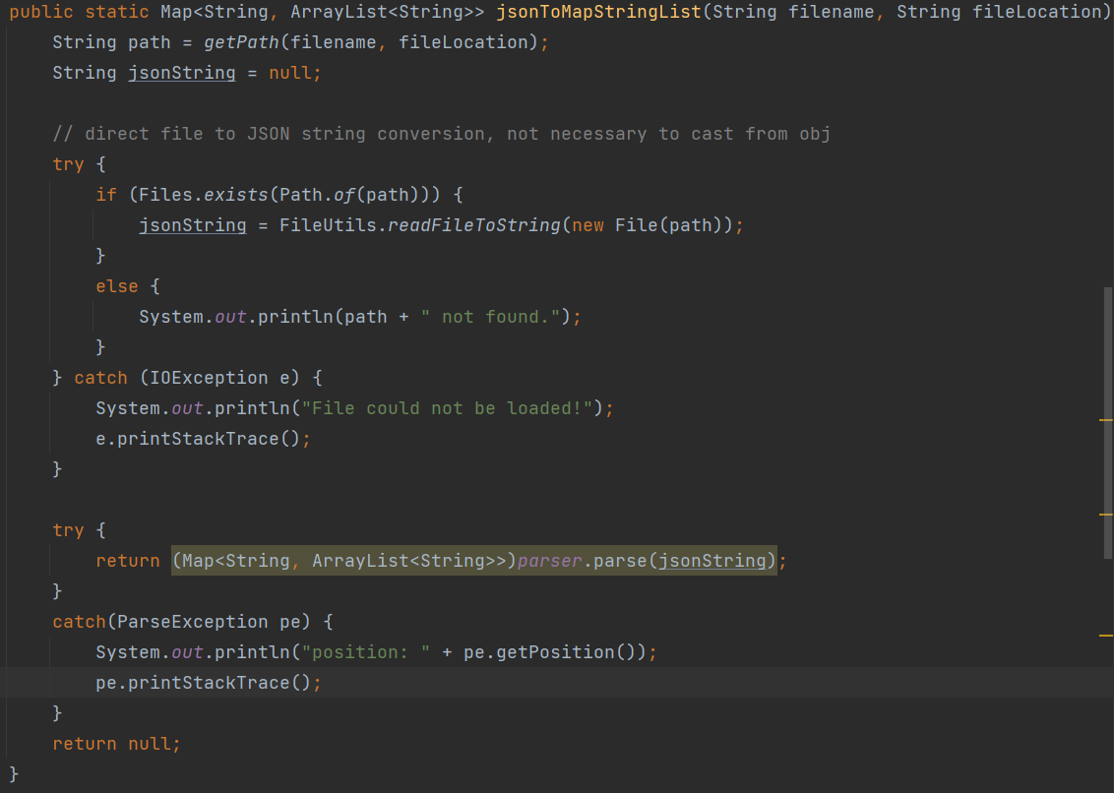
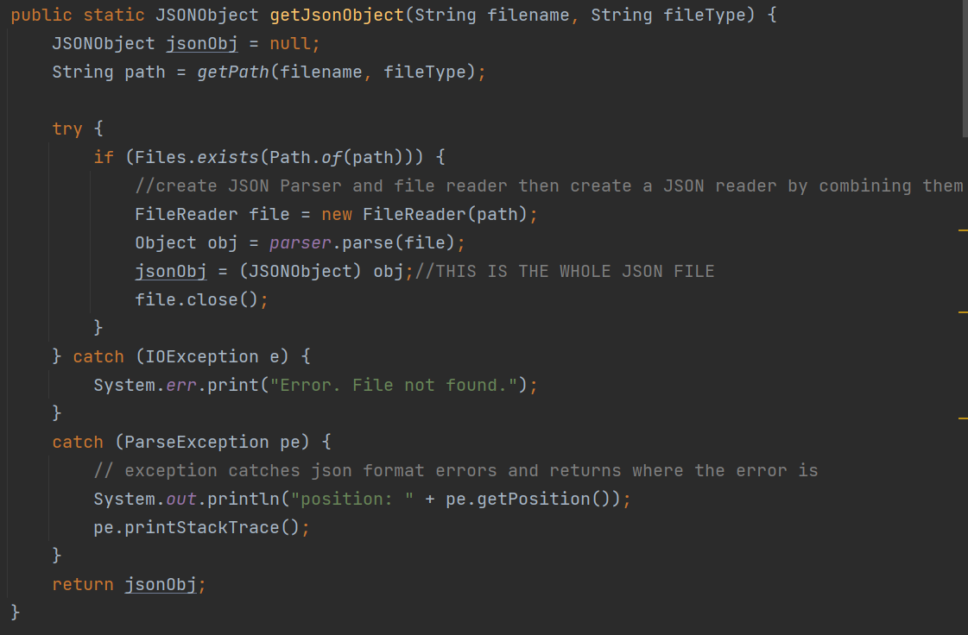
Learning/Challenges (justin)
Refactoring/Learning new JSON Parser

Slide 12
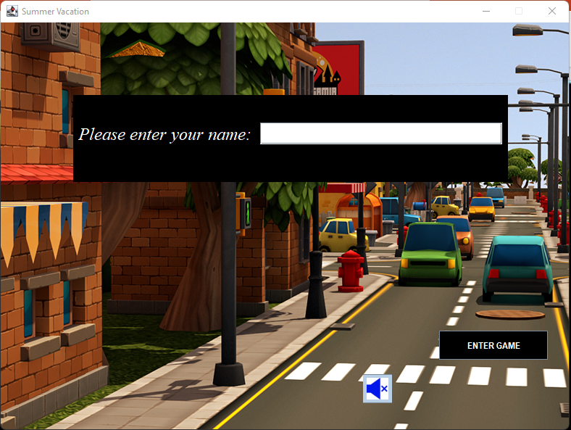
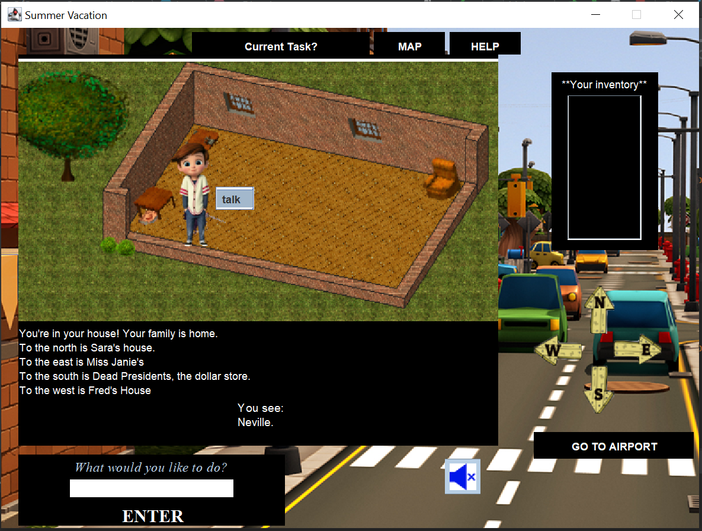
Game basics
You and your friends have just started summer vacation. After 2 weeks you and your best friend Sara have decided to explore the spooky old airport.
Use the navigation buttons and text input to explore, gather items, and "Scoobie Doo" some stuff.
If you get stuck there is a map and you can use the "help" button to get an idea of the types of commands you can use.
NPC talk
Help/Map/Current task
Text input
Navigation
Music on/off

Slide 13
Game demo

Slide 14
Stretch Goals
Add more functions to "use item" and "drop item" buttons.
"load game" button. -- We have function in code, but need to implement in GUI
Simplify the code.
Add inventory pics based on location
Better NPC experience
Add Volume Adjustor
Make game fully compatible with both user Input and buttons
More refactoring and de-coupling
More sound effects
More cohesive art

Slide 15

Questions?
What song is that?

